Slide 1
Week 12
NoSql scalability

Slide 2
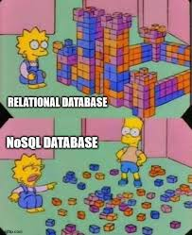
SQL vs NoSQL scaling
SQL
Vertical scaling is easier, lots of work needs to be done to do horizontal scaling
Relational
Strict Schema
NoSQL
Horizontal scaling is easier to setup on NoSQL
Non-relational so there isn't relationships to keep track of
Flexible schemas, and you don't always have to even have one at all
Designed to be used at scale

Slide 3
NoSQL architecture
Doesn't have to use ACID, there are lots of options for how transactions can work
High availability is assumed as part of the design
Horizontally scalable instead of vertical scalability
Dynamic provisioning for the servers to ensure you have exactly what you need and no more, easy to get more power when needed
Distributed data storage so you can have lots of different data types
Hybrid and multi-model databases are becoming common
So you can have multiple NoSQL types together, like document stores that also support key-value stores

Slide 4
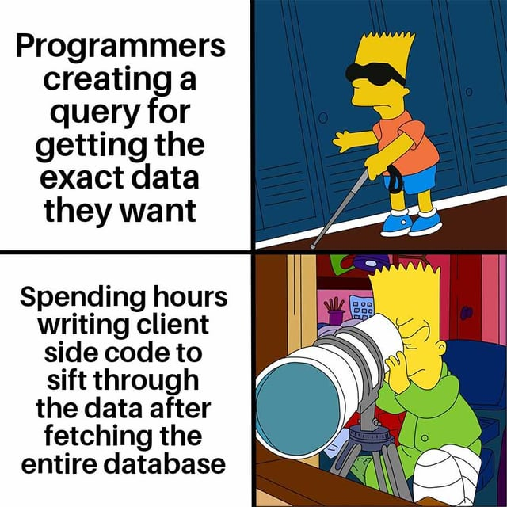
NoSQL scaling challenges
Data isn't guaranteed to be consistent immediately, it tends to have eventual consistency instead, can also have issues of corrupt data
Because there is no schema, storing the data, isn't the challenge, getting anything useful out of it is
New applications and integrations can be hard to build if the data isn't organized
The burden of finding how the data is organized and what you can get out of it falls to the application instead of the database, so the cost is moved not taken away
Once companies are big enough they need more from their data, have data analysts working, and will care more about things like downtime

Slide 5
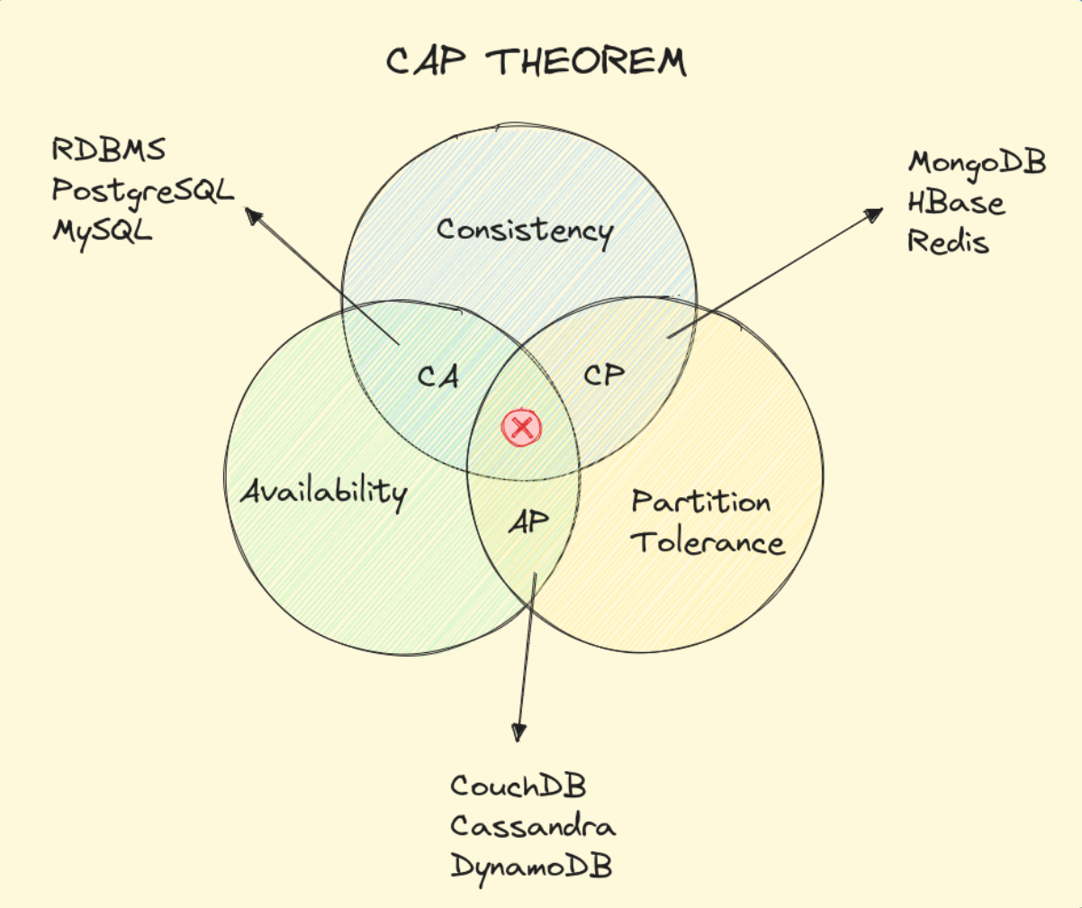
CAP Theorem
NoSQL databases are scaled horizontally so they are considered distributed computing
Distributed databases has an idea that says you can have Consistency, Availability or Partition tolerance, but you can't have all three at once
Consistency means that the data has to be up to date or throw an error
Availability says everything must get a response unless it's a failing node
Partition tolerance says that the system must work even when messages are lost/delayed
Because network communication is considered lossy, no one gives up partition tolerance, so you have to pick one of the other two to give up
SQL without scale is done on one node so no communication is lost
https://alperenbayramoglu.com/posts/understanding-cap-theorem/

Slide 6
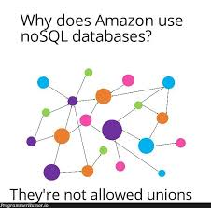
Sharding
NoSQL databases will also use sharding to scale up
Breaking the database into pieces, or shards, is important for both SQL and NoSQL
NoSQL sharding tends to happen in the background, rather than needing to worry about it like SQL does
NoSQL databases were designed to scale using sharding so it's more inherent in the use
Shards are equal so there is less load balance needed
Communication is still important, gossip protocol is used
Data can be copied to other shards equally since the shards are equal

Slide 7
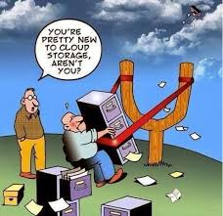
Cloud options and outsourcing
Database-as-a-Service (DBaaS)
This is a third party you can buy your database from
Popular for people that don't have in house DB talent, and small companies that don't want to invest yet
Hosted
Having a Virtual Machine (VM) or virtual image can be stored on cloud servers and easily used
Several companies make their money hosting VMs for people

Slide 8
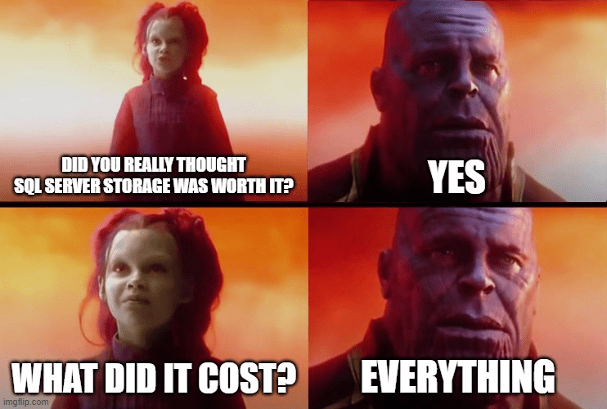
Database-as-a-Service
Turnkey options, this is a third party that takes care of your database needs
NoSQL vendors can get pricey fast. Consultants for the vendor can be a hidden cost. Consultants can cost several thousand a day
Because everything is done by the third party, you don't have to worry about much of anything
Vendor lock-in is also an issue, switching vendors can be a VERY big problem

Slide 9
Hosted VM
Hosting on cloud providers like AWS, Azure, and Google Cloud is one of the most popular solutions for companies of all sizes because it can be a good intersection of cost + skill compared to DBaaS
Using a hosted VM means you have to have someone in house to run the database and be on call for it
This will allow you to not have the infrastructure and IT costs associated with your own servers
Database maintenance needs to be done by you, and this includes everything from general backups to data security
A middle ground between Hosted VM and DBaaS is where the cloud company hosts a database for you
This won't have 24/7 on call service like a DBaaS might
Cheaper than a DBaaS

